Slide 1
BOOK-A-TA
Team SHAR-knado
Boris, Jayden, John, Vera
Youtube: https://youtu.be/c3iZtiKrVzI

Slide 2
TABLE OF CONTENTS
01
02
03
PROJECT OVERVIEW
SOLUTION
BACKEND
Objectives, Styling and Design
Databases, APIs, and Beyond the Lab

Slide 3
PROJECT OVERVIEW
PROBLEM
SOLUTION
Student only apply for TA positions to profs via email or adhoc communication
Currently, the selection and payment processes are manual and segregated.
Our team will be designing a website that connects SMU professors, school administrators and students who want to apply as Teaching Assistants (TA).
Notes:
Problem: Qualified people who would like to apply for TA positions may not know about the current openings available
Solution: Website serves to be a centralised location for profs to add openings and students to apply

Slide 4
02. SOLUTION - OBJECTIVES
Portal
Admin
Professor
Teaching Assistant
Make payment to TAs that have completed their role.
Create TA job listings and accept applications for their job listings.
Students can browse for various TA listings on the platform and apply accordingly. Also, they can view payment details on the website.

Slide 5
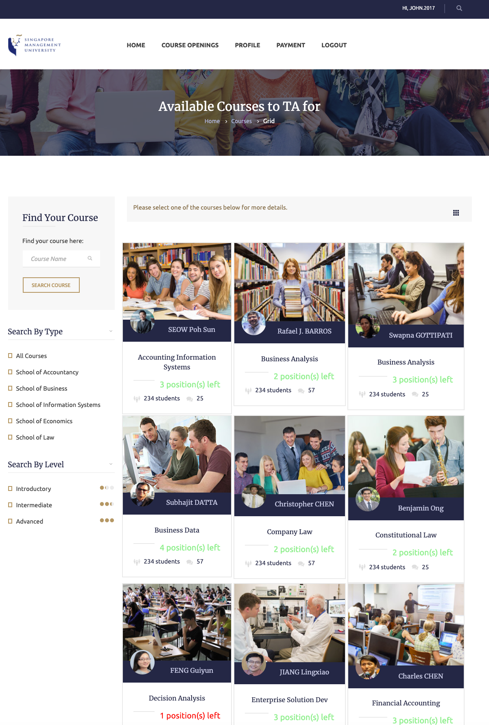
02. SOLUTION - STYLING & DESIGN
Color scheme
Blue, white and gold -> SMU colors
Styling
Clean, intuitive, user-friendly UI for all users
Technologies
Based on CSS Bootstrap, HTML, JavaScript
Figure: UI for students to browse through the various TA openings
Notes:
Based on Bootstrap 3, which is one of the requirements
Colour scheme: SMU’s brand colours were used to maintain brand identity
Styling: Most of the front end styling is done through bootstrap and CSS while javascript is used to alter site elements

Slide 6
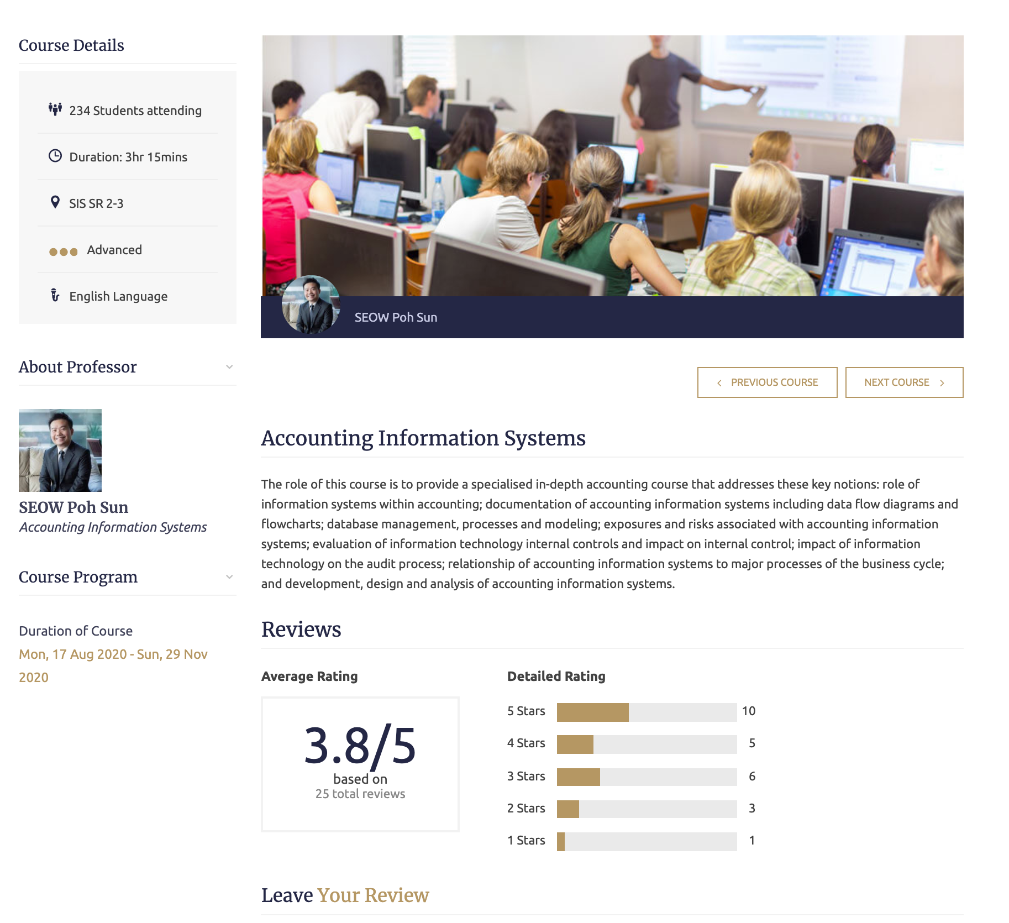
02. SOLUTION - STYLING & DESIGN
Figure: UI when user clicks on the card of a TA listing
Notes:
Based on Bootstrap 3, which is one of the requirements
Colour scheme: SMU’s brand colours were used to maintain brand identity
Styling: Most of the front end styling is done through bootstrap and CSS while javascript is used to alter site elements

Slide 7
03. BACKEND - DATABASE & BEYOND THE LAB
DATABASE
BEYOND THE LAB
MySQL
Update database via AJAX calls to Flask-MicroServices
Allows elements to be added or changed based on the user's input
GitHub
Version control
See what has been changed
Roll back certain changes
Debugging
Notes:
Database: To connect our front end with the back end, we have utilised ajax to call flask microservices to pull information from the MySQL database. This allows elements such as TA application details to be added or changed based on user input
Github: Version control, to see what has been changed and aid debugging

Slide 8
03. BACKEND - APIs
 | DESCRIPTION
PAYPAL | Payment transactions from school administrators to TAs
GOOGLE | Authentication and authorization
GMAIL | Notify TAs of their application status
Notes:
REST API - provides simple payment processing for common business needs, including PayPal payments, direct credit card payments, authorization and capture, and refunds
Google API - Securely call Google APIs with OAuth 2.0 authorization. Google APIs use the OAuth 2.0 protocol for authentication and authorization of accounts.
Gmail API - Read and send messages, manage drafts and attachments, search threads and messages, work with labels, setup push notifications, and manage Gmail settings.

Slide 9
LIVE
DEMO

Slide 10
THANK
YOU

